Slide 1
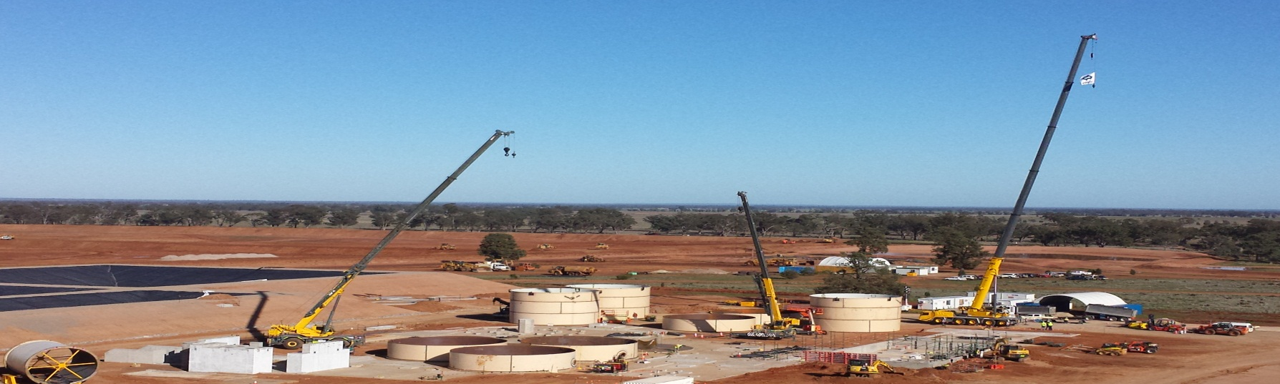
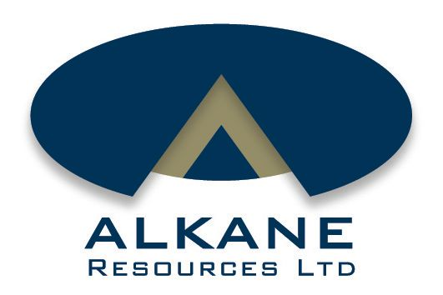
Tomingley Gold Project
7 Years On…
September 2013
David Meates
Ian Chalmers
Terry Ransted
Notes:
This is an update to the last technical presentation we did at a M&W 7 years ago and as seen from the photo, 12 years on from discovery things are starting to develop nicely… A couple of names to mention who aren’t here today but Ian Chalmers our MD and Terry Ransted the chief geo both remain closely involved with the project.

Slide 2
Acknowledgements
Rimas Kairaitis (Alkane-YTC Resources Ltd)
Dr Anthony Crawford (A & A Crawford Geological Research Consultants)
Peter Schaubs (CSIRO)

Slide 3
Summary
Significant orogenic gold in Ordovician volcanics of Eastern Lachlan
Global Resource (excl Caloma Two): 12.6Mt @ 2.0g/t Au (811,700oz)
7 year mine life to produce 50-60,000ozpa at 1Mpta
Development approval February 2013, first production early 2014
Caloma Two resource calc. underway - Significant intercepts inc:
  70m grading 1.89g/t gold from 176m (PE788)
  9m grading 110g/t gold from 194m
  including 1m grading 822g/t gold (PE873)

Slide 4
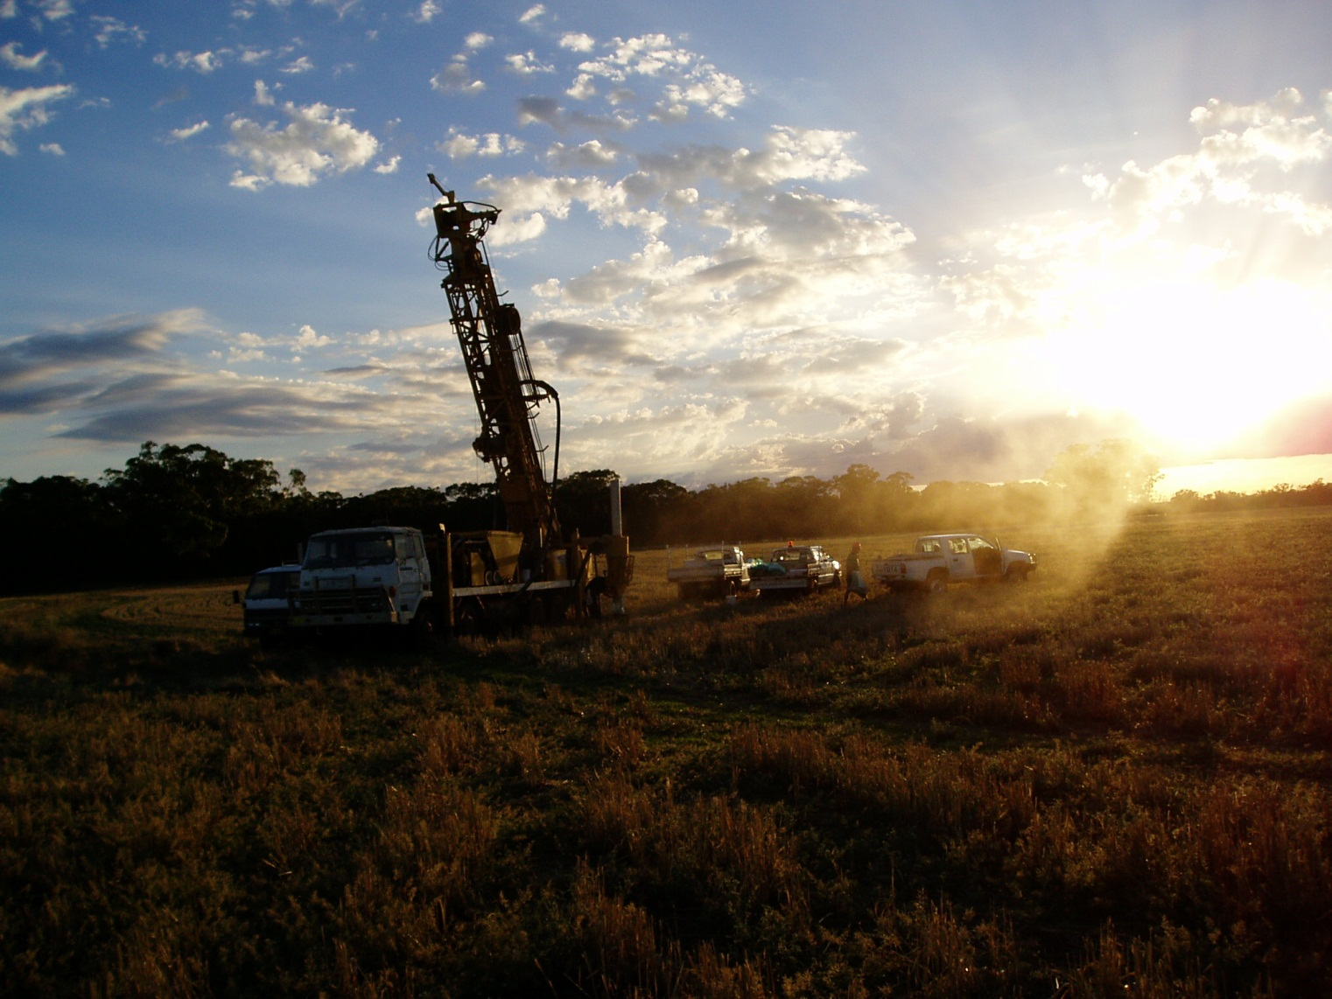
Background

Slide 5
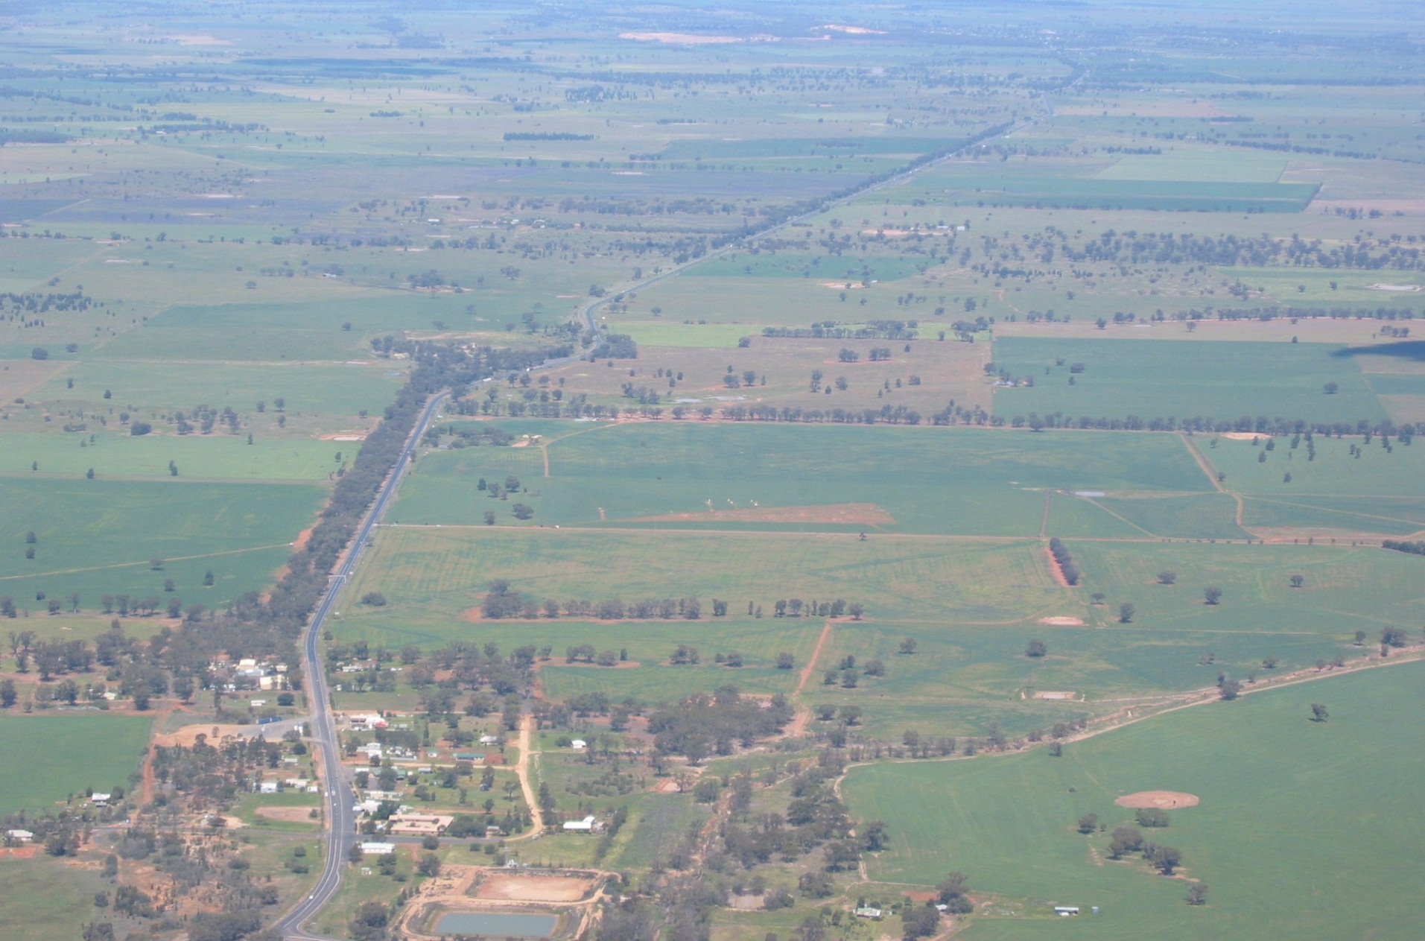
Background
Peak Hill Gold Mine
0.7Moz
Myalls United Mine
60,000oz prd.
Wyoming One
390,000oz
Caloma Two
tbc
Wyoming Three
50,000oz
Caloma
370,000oz
Tomingley Village
Newell Highway
Notes:
TGP aerial photo with sites of interest

Slide 6
Background
2001 Tenements acquired from Compass Resources and Golden Cross Resources through royalty from production.
2004 Wyoming deposits open cut resources defined.
2005 Preliminary feasibility study on Wyoming deposits was not positive.
Wyoming One underground resource subsequently defined.
2009 Caloma open cut resource defined.
2011 Positive definitive feasibility study completed.
EA with development approval sought.
2013 Mining lease granted, construction commences.
Caloma Two resource definition underway.
Notes:
Wyo Resource Summary

Slide 7
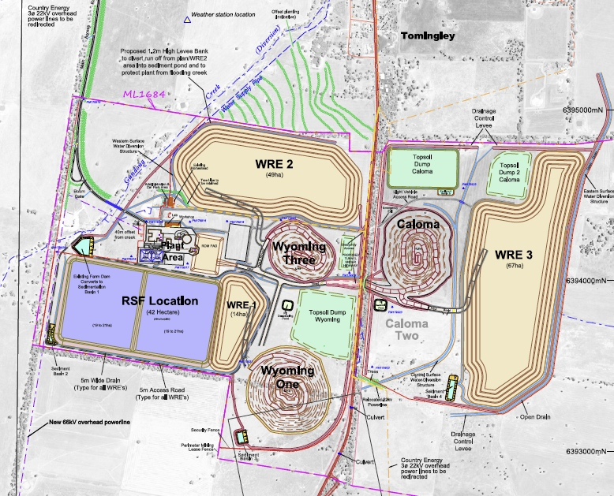
Background
Infrastructure:
  water => 45km pipeline
  power (State Grid) => 20km 66Kv power line
  roads => primary & secondary access
Skilled local workforce
  population base of 150,000 within 120km diameter area
  No FIFO
Site layout

Slide 8
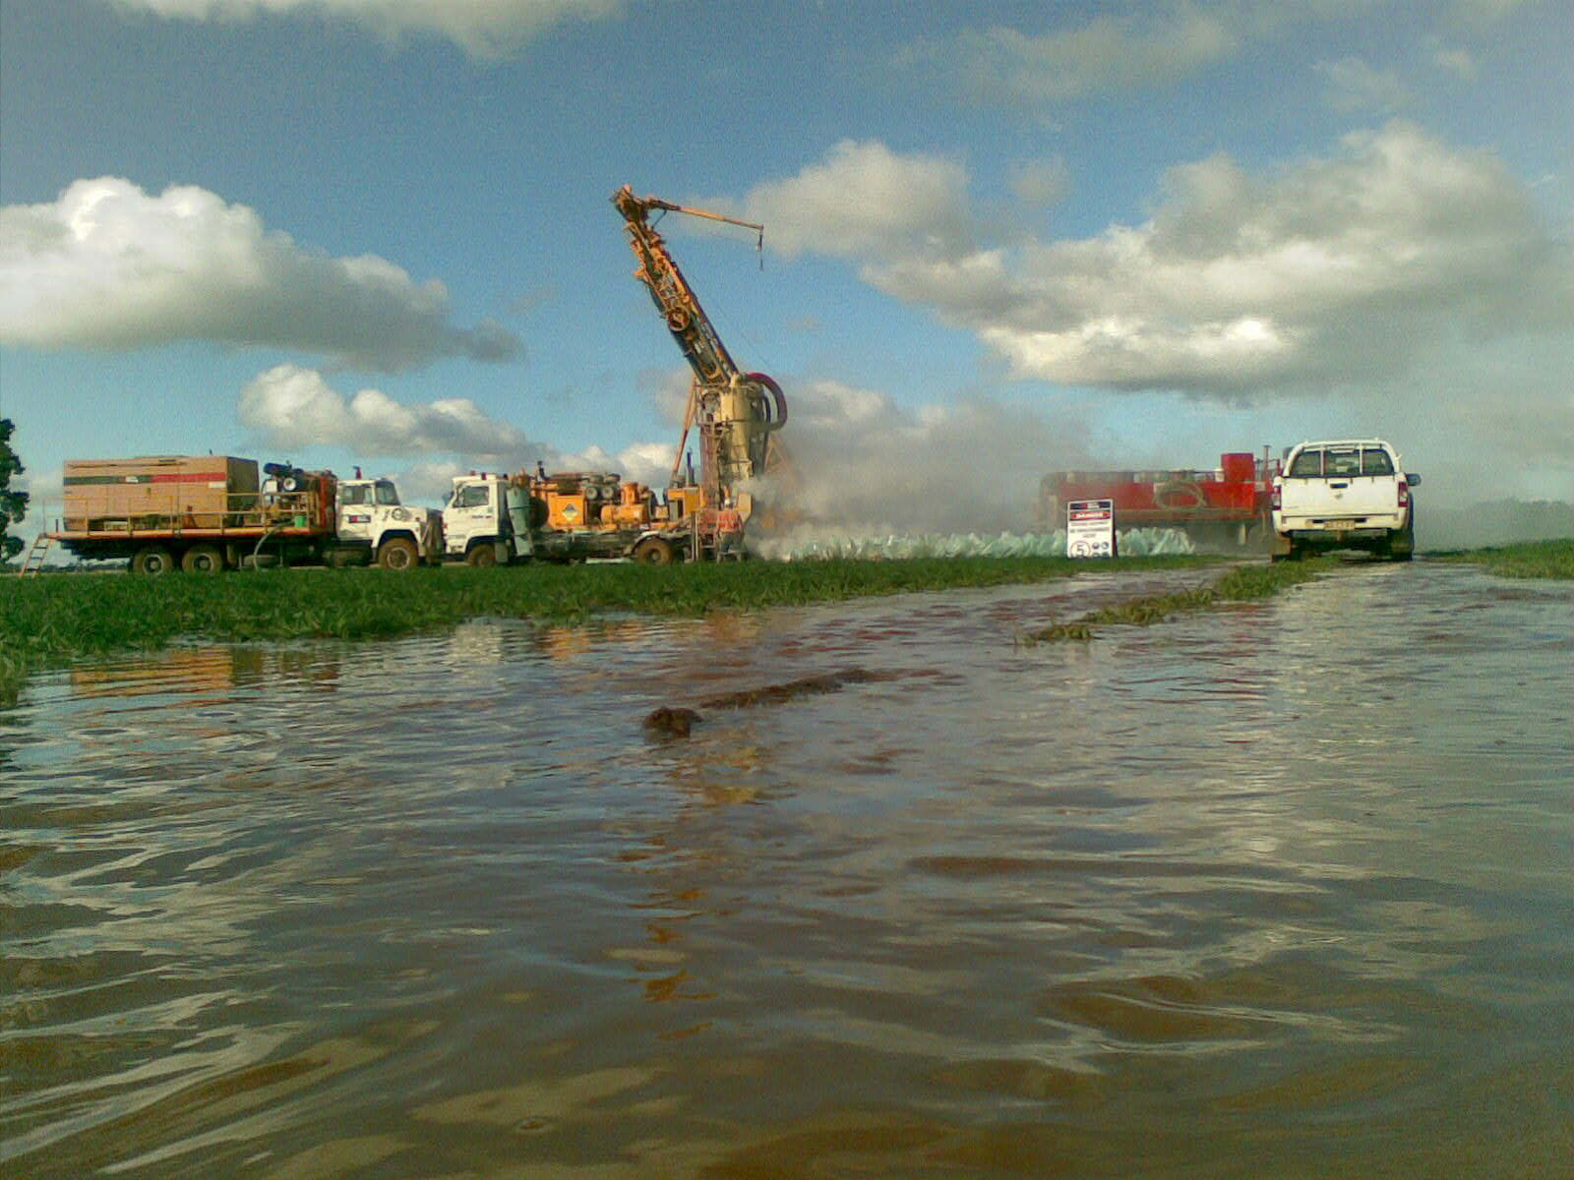
Geological Setting
Caloma Two initial RC drilling
July 2010

Slide 9
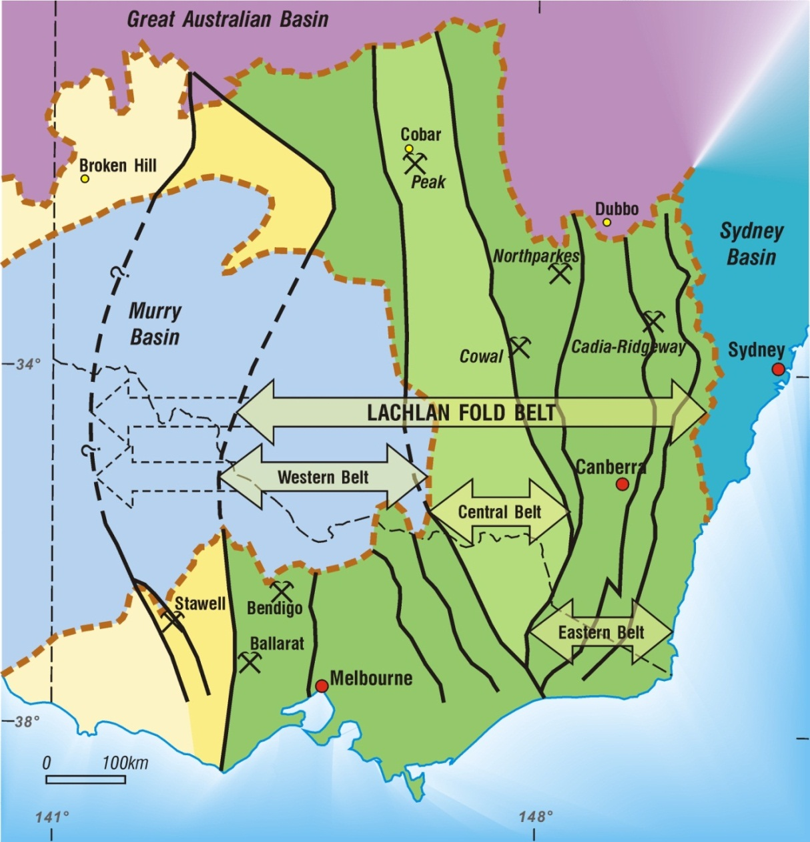
Structural Divisions of the
Lachlan Orogen
Geological Setting

Slide 10
Macquarie Arc
Major Deposits
(Modern)
Geological Setting
Tomingley
0.8M oz
Dubbo
Northparkes
1.5M oz
Wellington
Rockley
Gulgong
Volcanic
Belt
Peak Hill
0.7M oz
Junee
Narromine
Volcanic
Belt
Molong
Volcanic
Belt
Parkes
Cowal
6M oz
Forbes
Orange
Younger granites
Bathurst
Monzonitic intrusions
Ordovician arc volcanics
Fifield complexes
Gidginbung
0.7M oz
Cadia Valley
44M oz

Slide 11
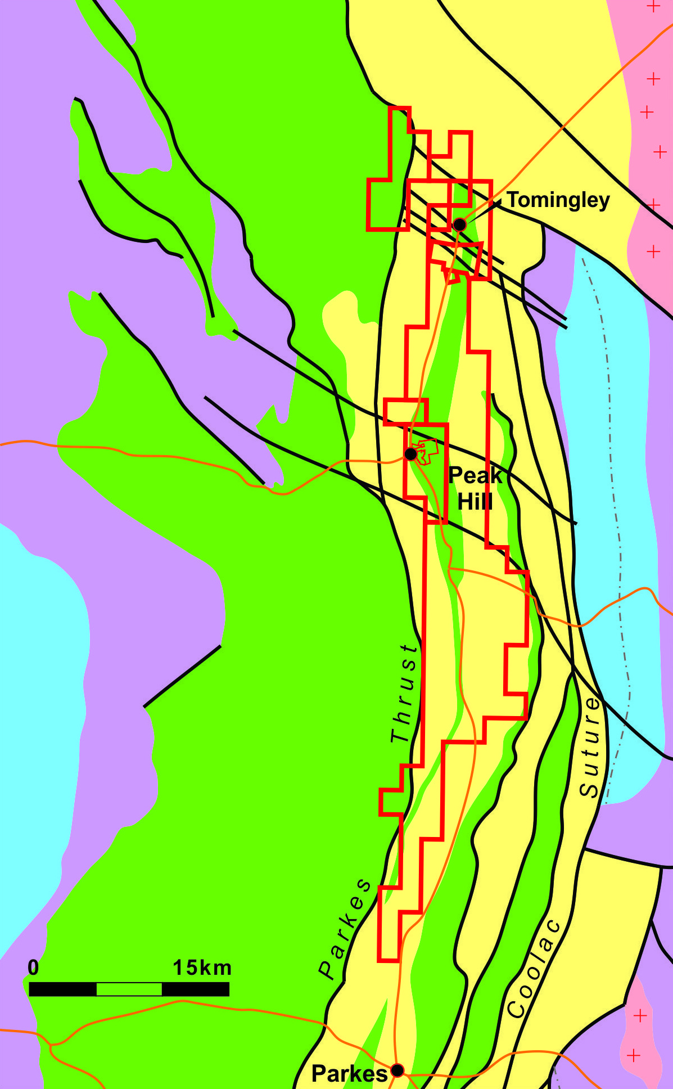





TGP Tenements
Regional Geology
Mingelo
Volcanics
TGP
PHGM
Late Devonian sediments
Early Devonian granites
Late Silurian to Mid Devonian volcanics
and sediments
Northparkes
Ordovician to Silurian sediments
Ordovician volcanic complexes

Slide 12
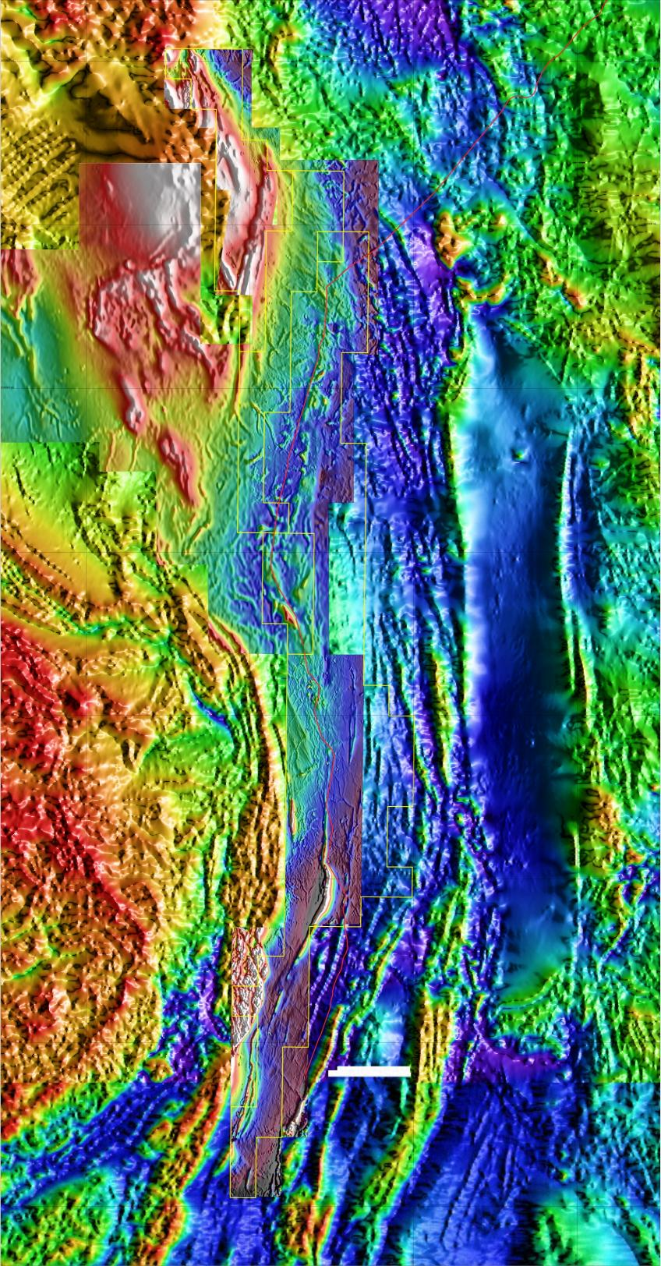
Parkes - Narromine
Regional
Aeromagnetics
Merged
Alkane detailed with DMR regional data
Tomingley
Peak Hill
LTZ
North Parkes
Parkes Thrust

Slide 13
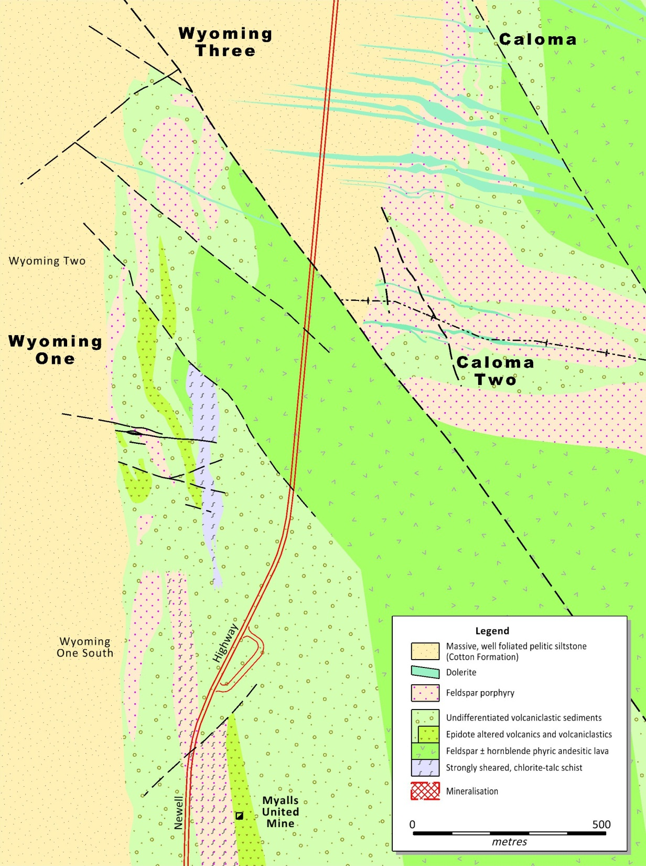
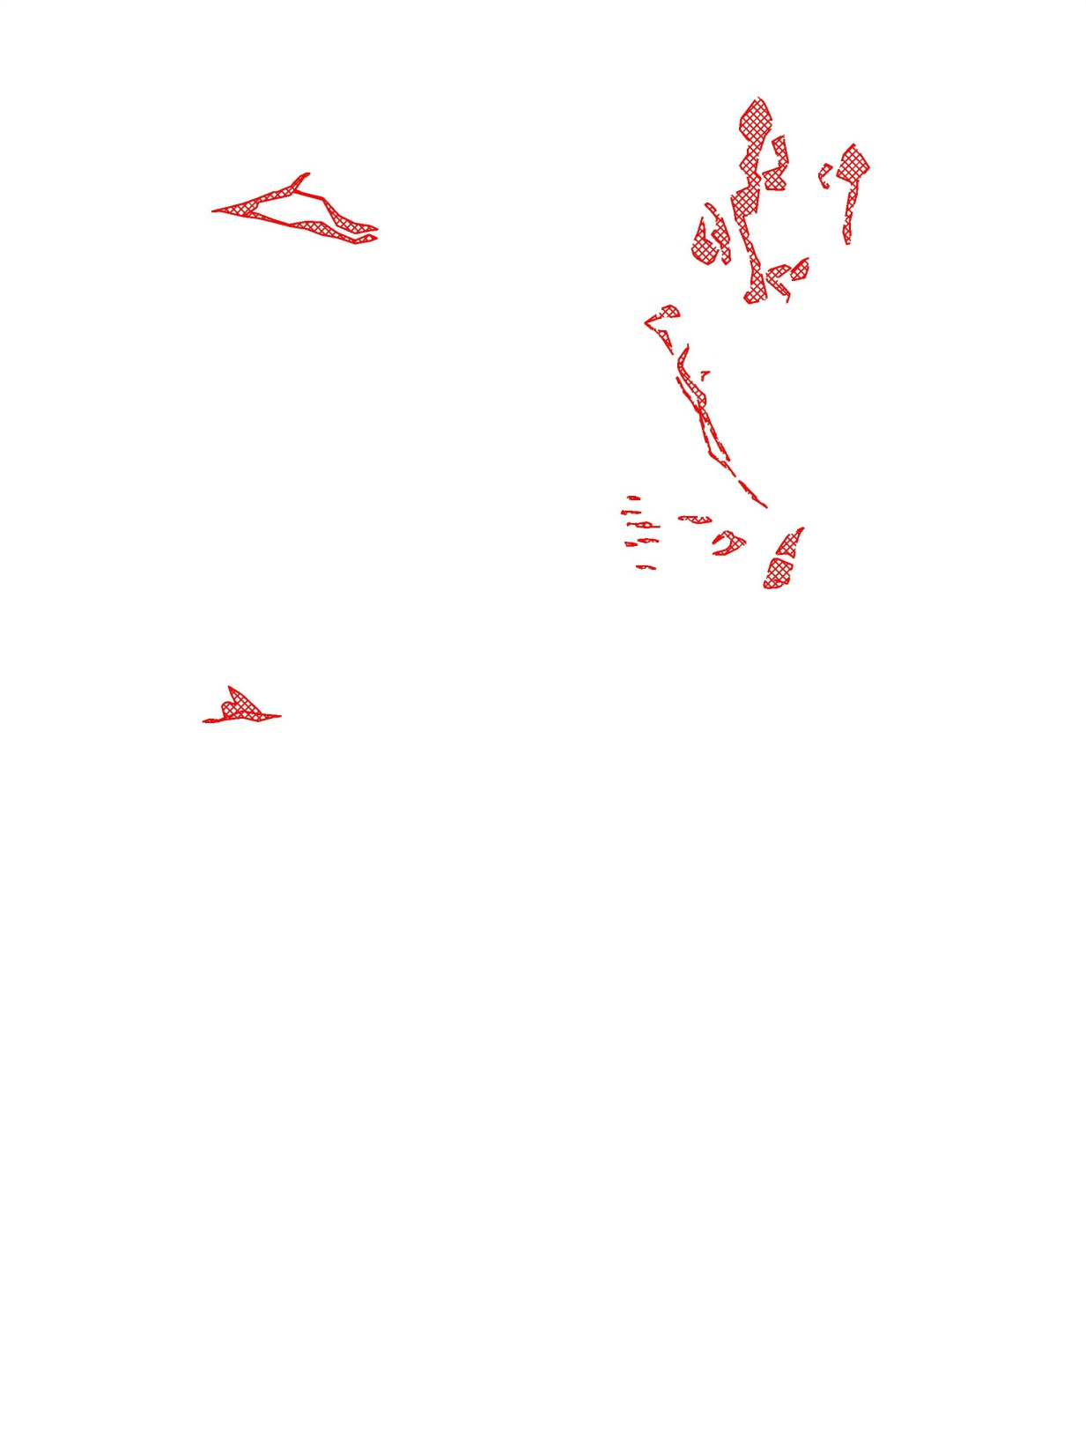

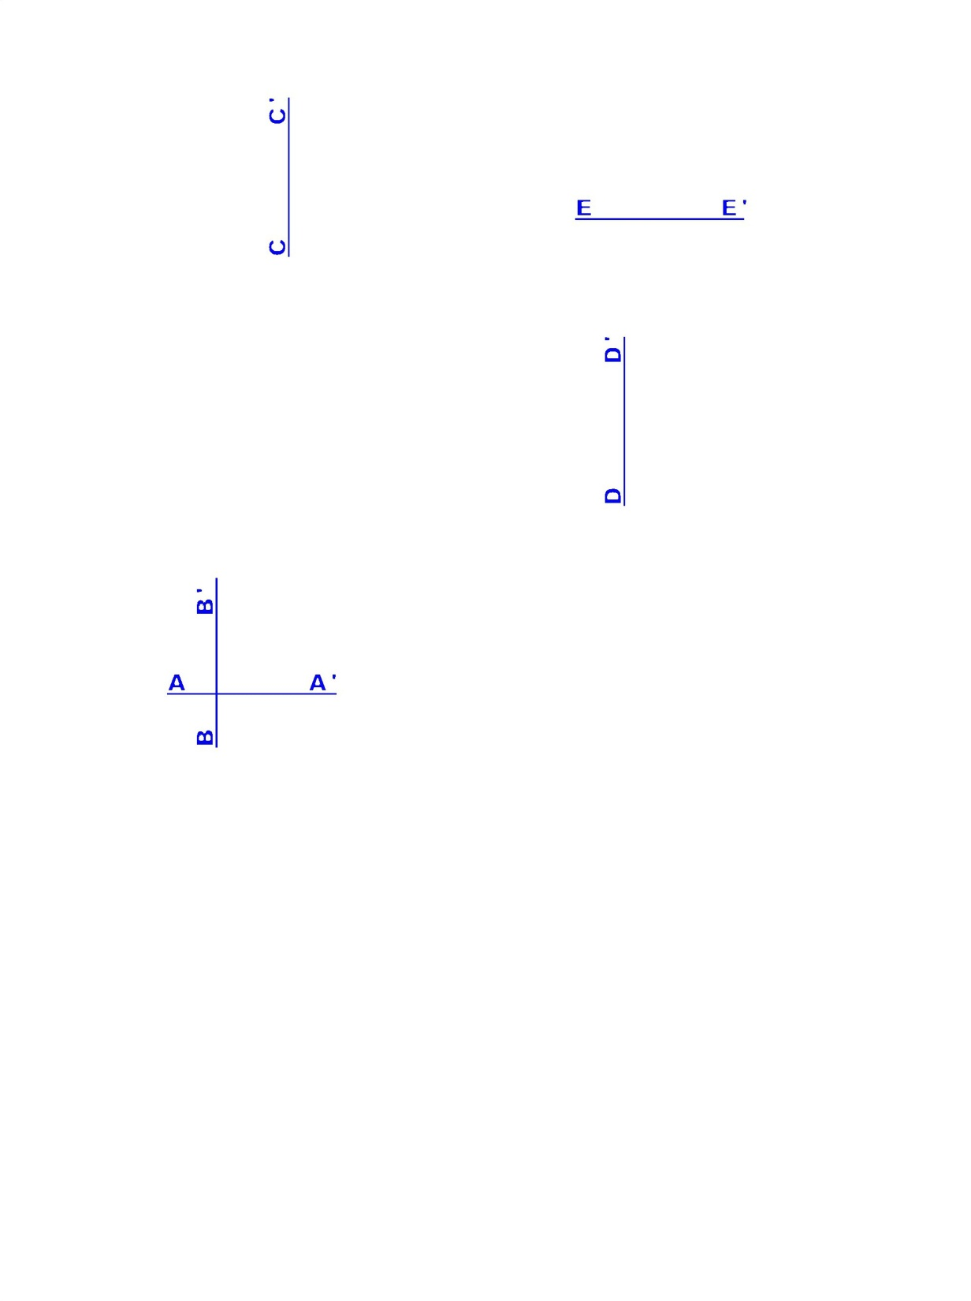
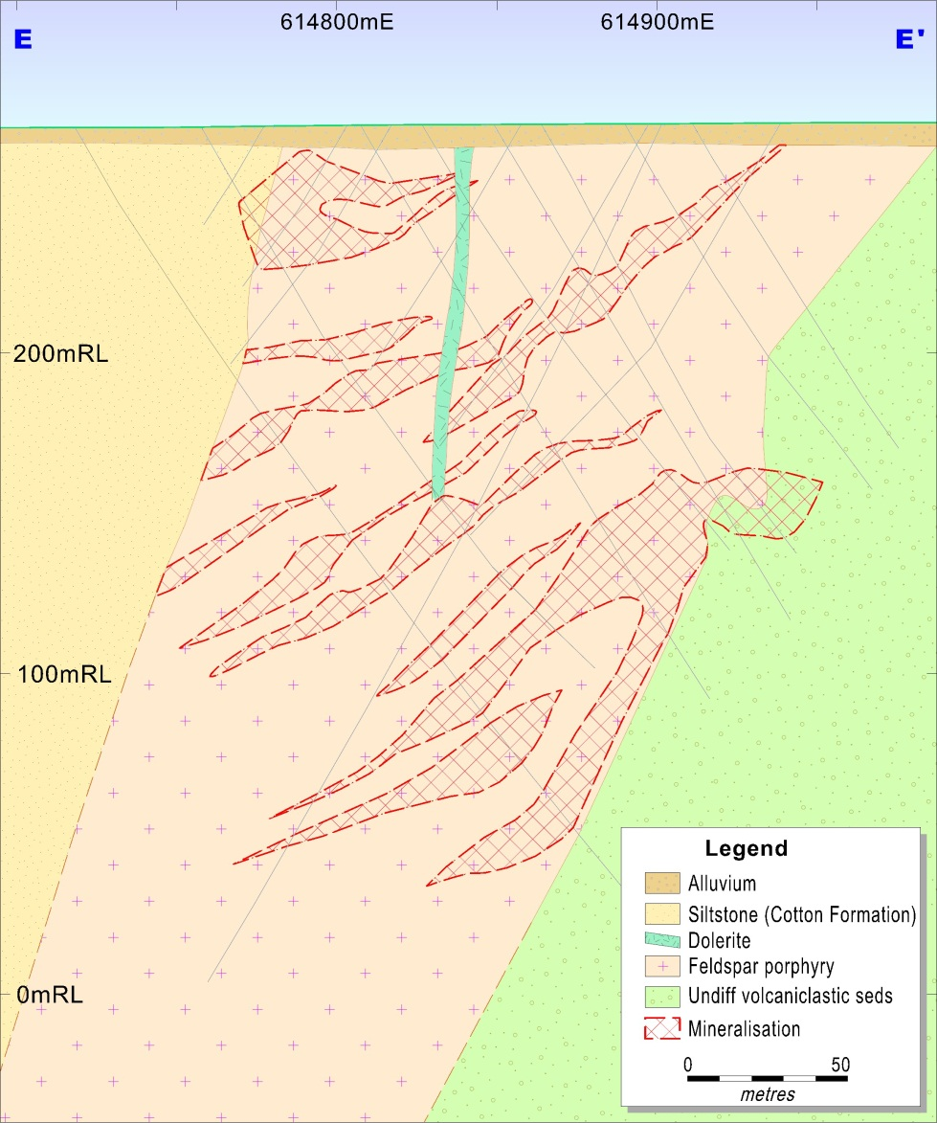
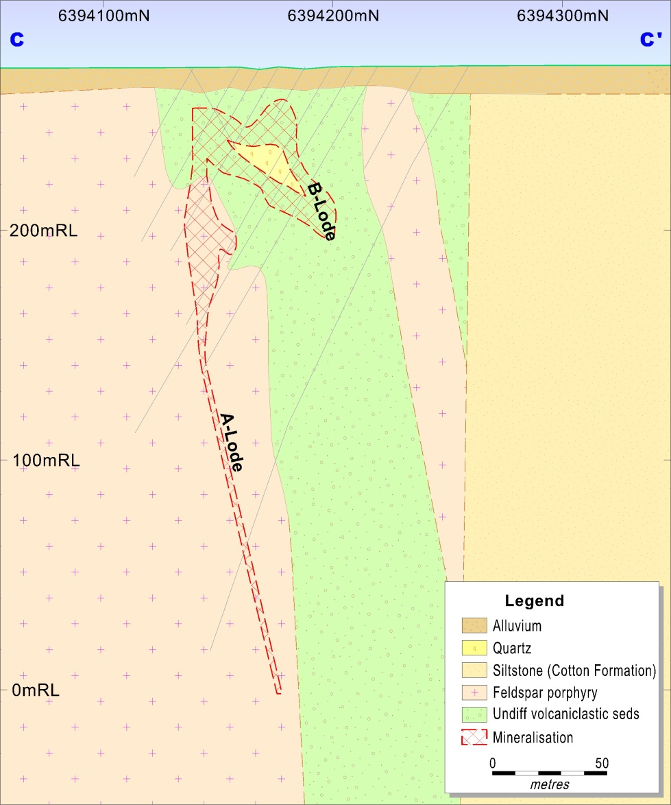
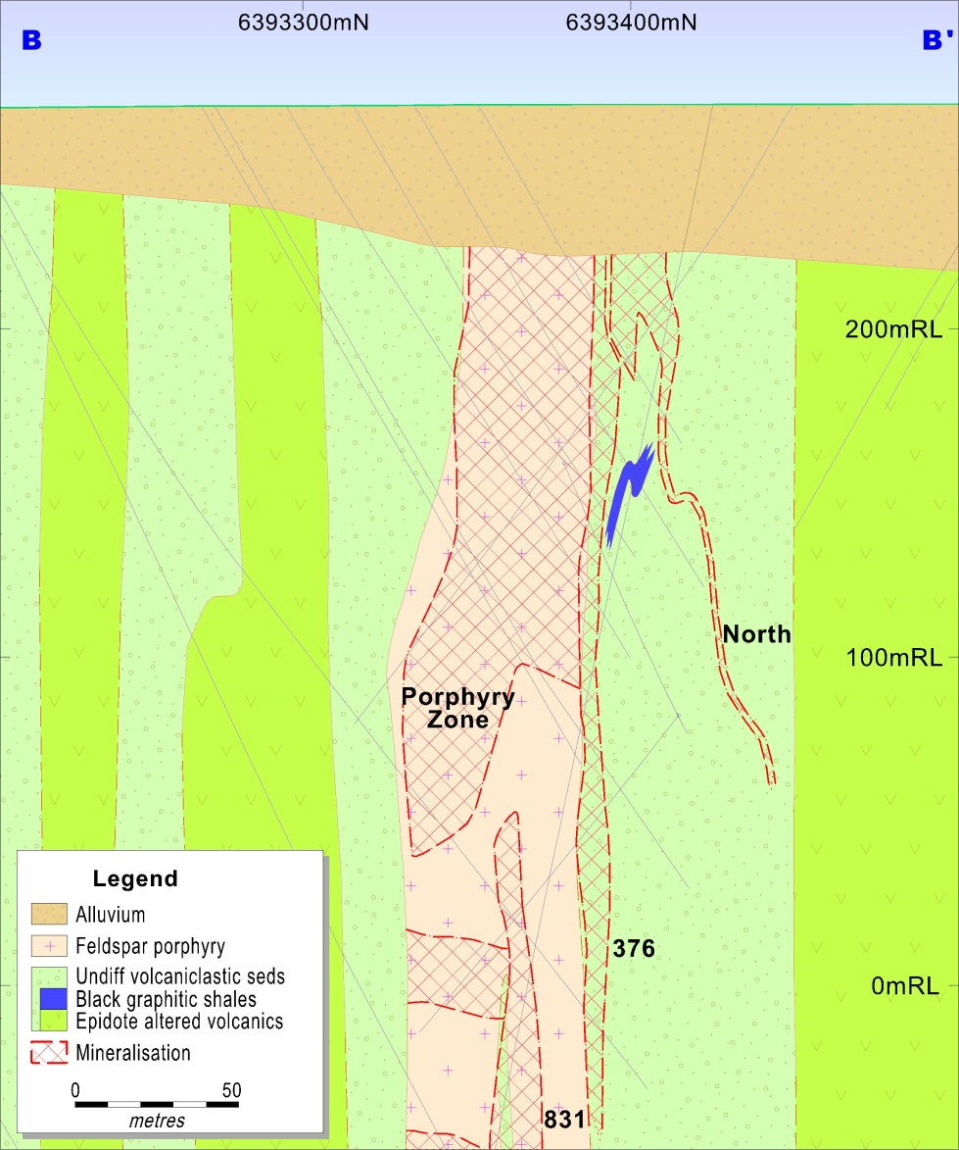
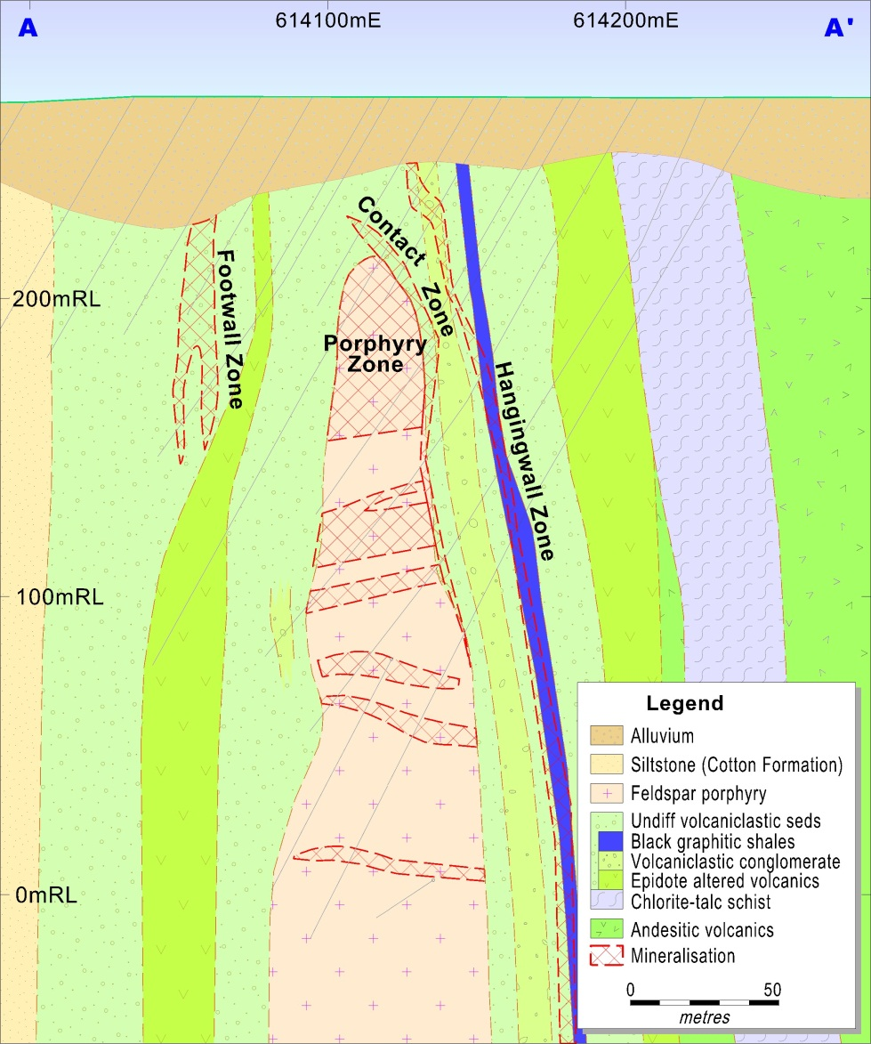
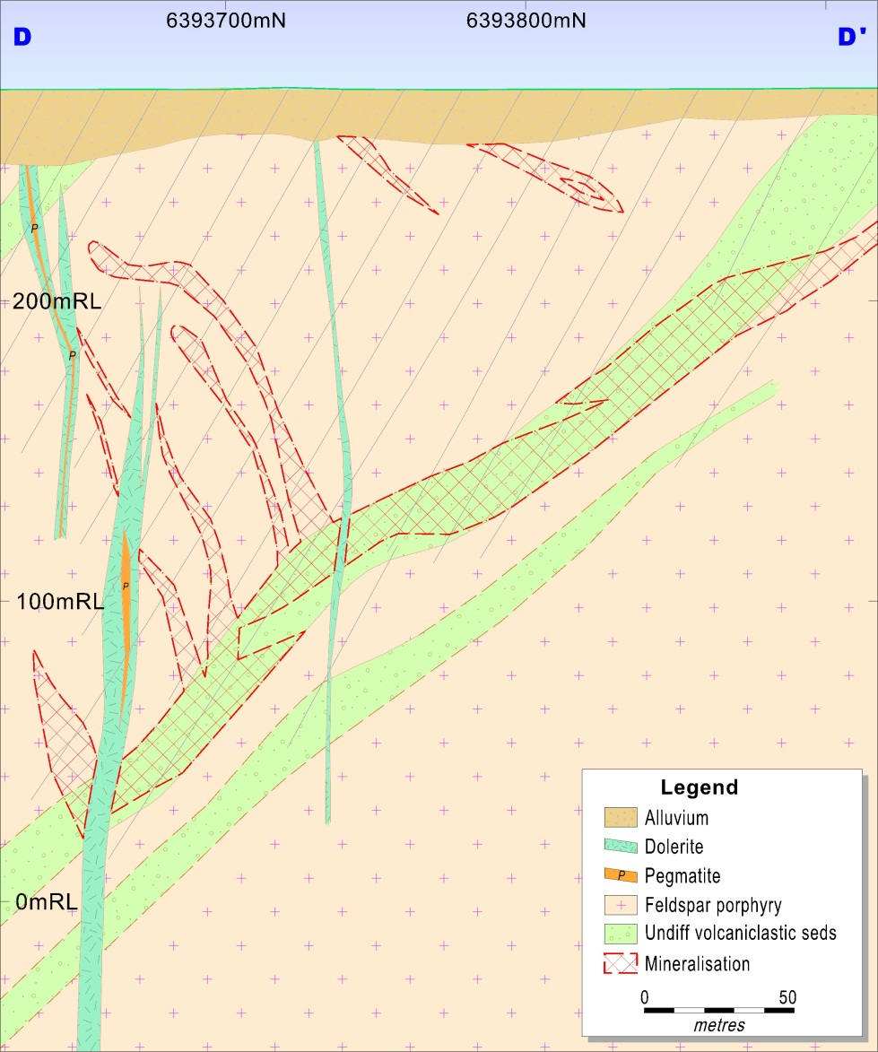
Local Geology
392,000oz @ 1.9g/t Au
Resource to be calculated
392,000oz @ 1.9g/t Au
369,000oz @ 2.1g/t Au
50,000oz @ 1.9g/t Au
Ore zones hosted within or along margins of feldspar phyric monzodiorite sills
Geology concealed by variably thick magnetic overburden
Deep weathering profile
East-west compression followed by dextral wrenching
Extensional post-mineralisation dyking
Notes:
Wyoming geology summary

Slide 14
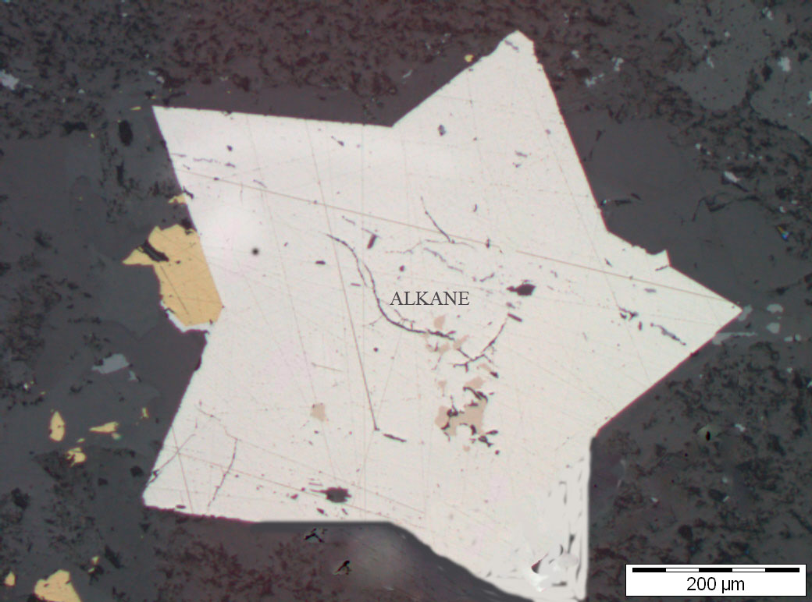
Ore Genesis
Arsenopyrite in Caloma core

Slide 15
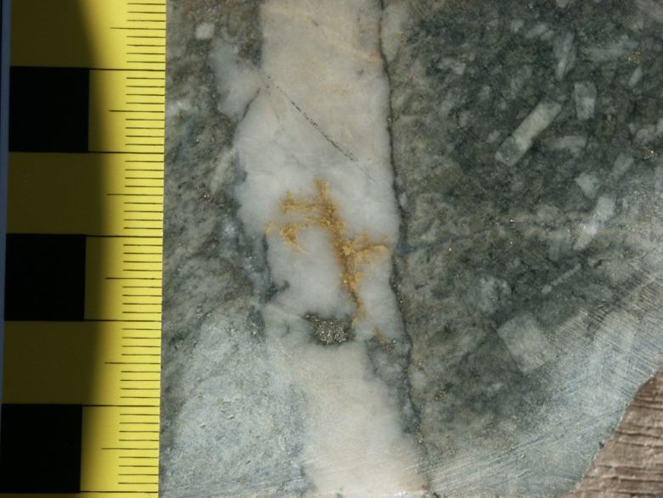
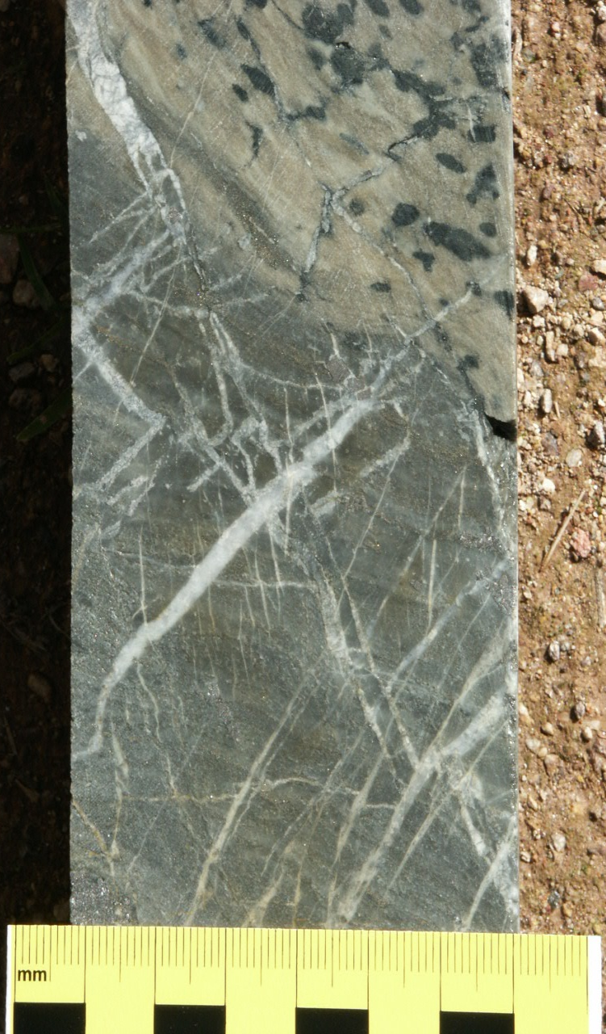
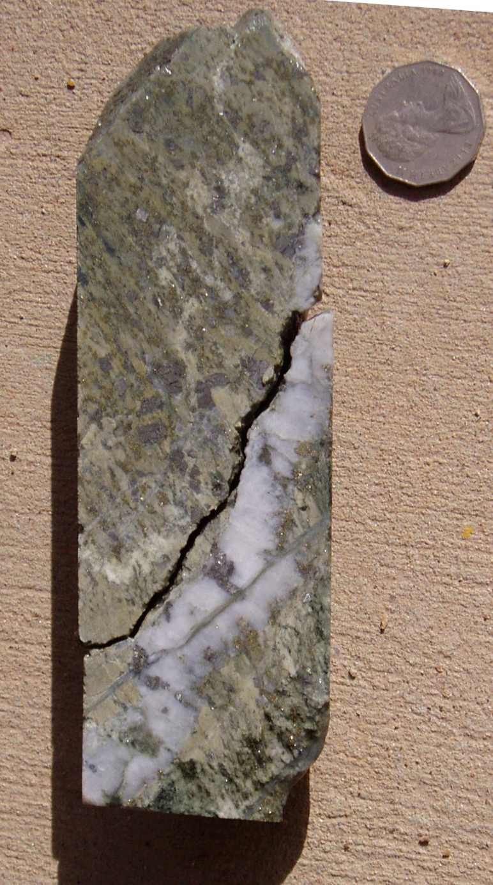
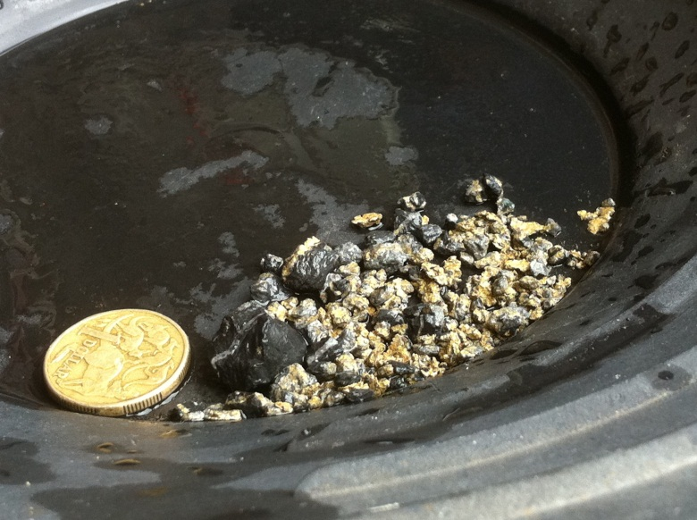
Ore Genesis
Multiphase alteration assemblage: sericite – ankerite – albite – chlorite – quartz – (fuchsite)
Weak zoning of carbonate spotting (ankerite)
Mineralisation: pyrite – arsenopyrite (up to 5% As) trace: sphalerite, chalcopyrite, pyrrhotite
Gold forming within brittle fractures within quartz veins and pyrite
2 significant deformation events, E-W compression and subsequent dextral transpression
Middle Devonian Tabberabberan Orogeny likely
Apy

Slide 16
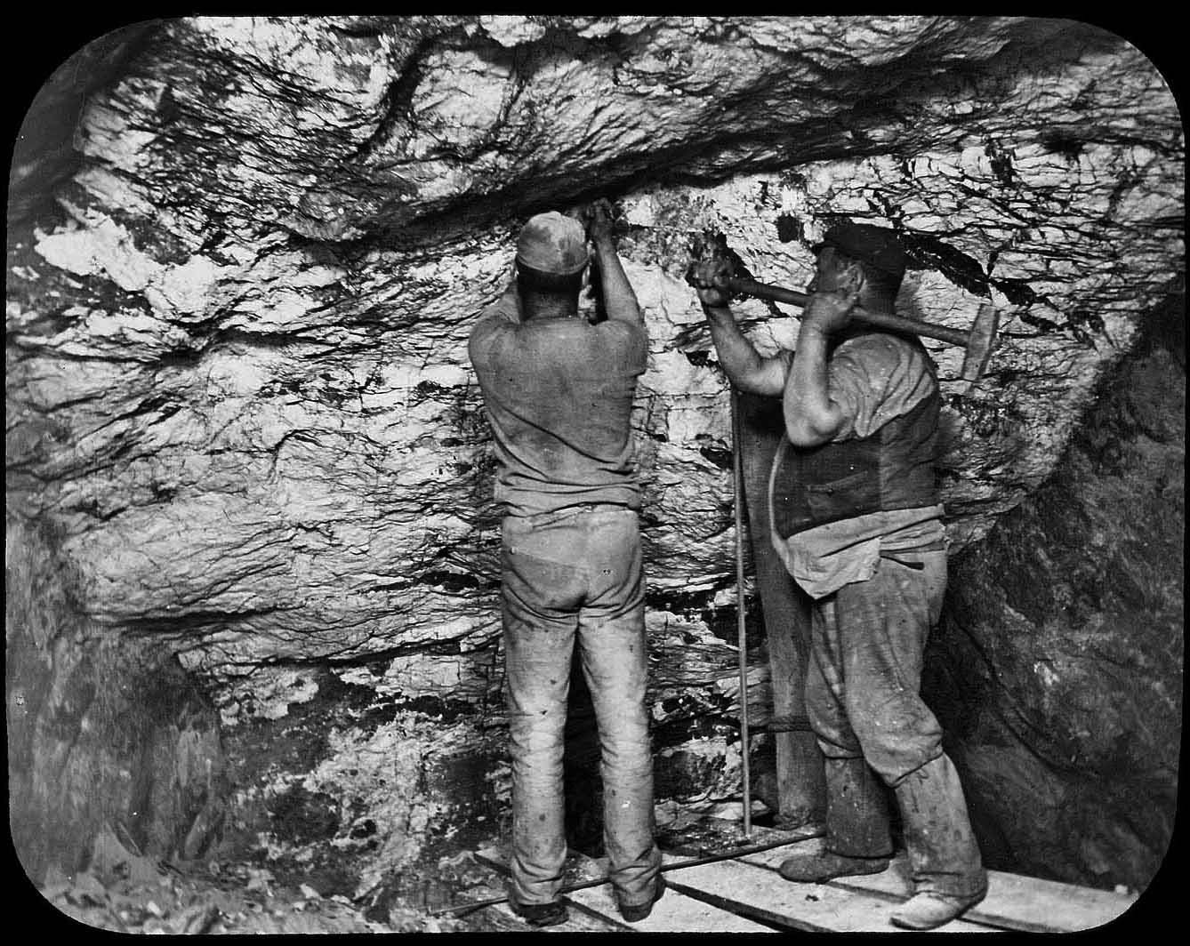
Discovery History
Myalls United Lode 1883 - 1912
Notes:
Wyo Resource Summary

Slide 17

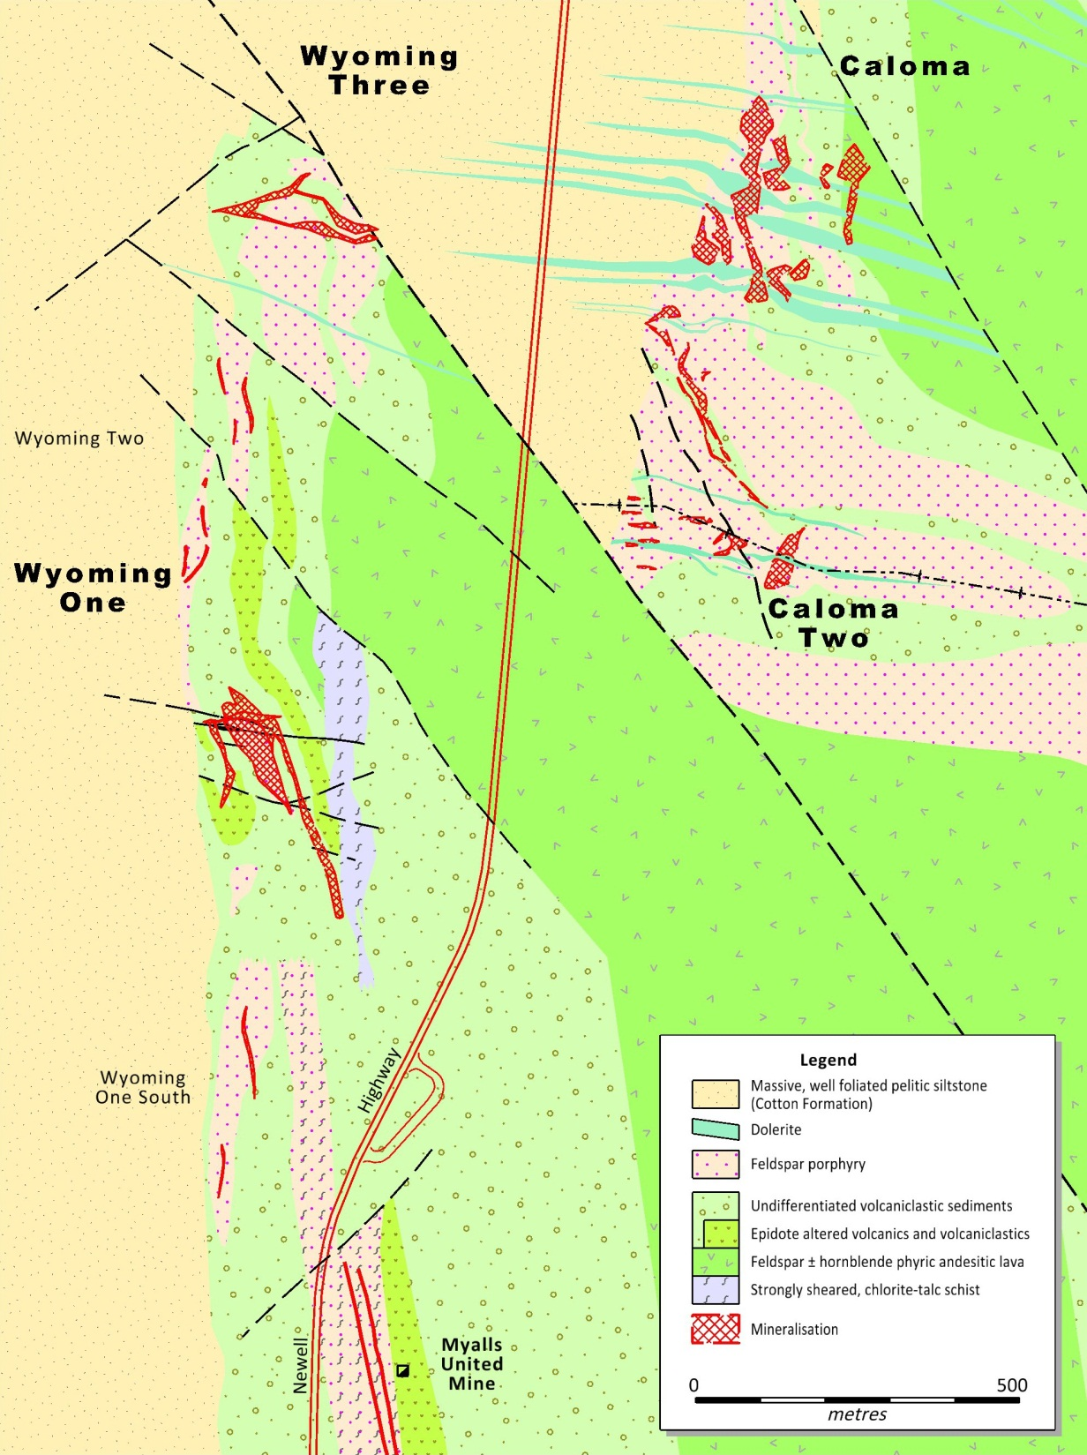



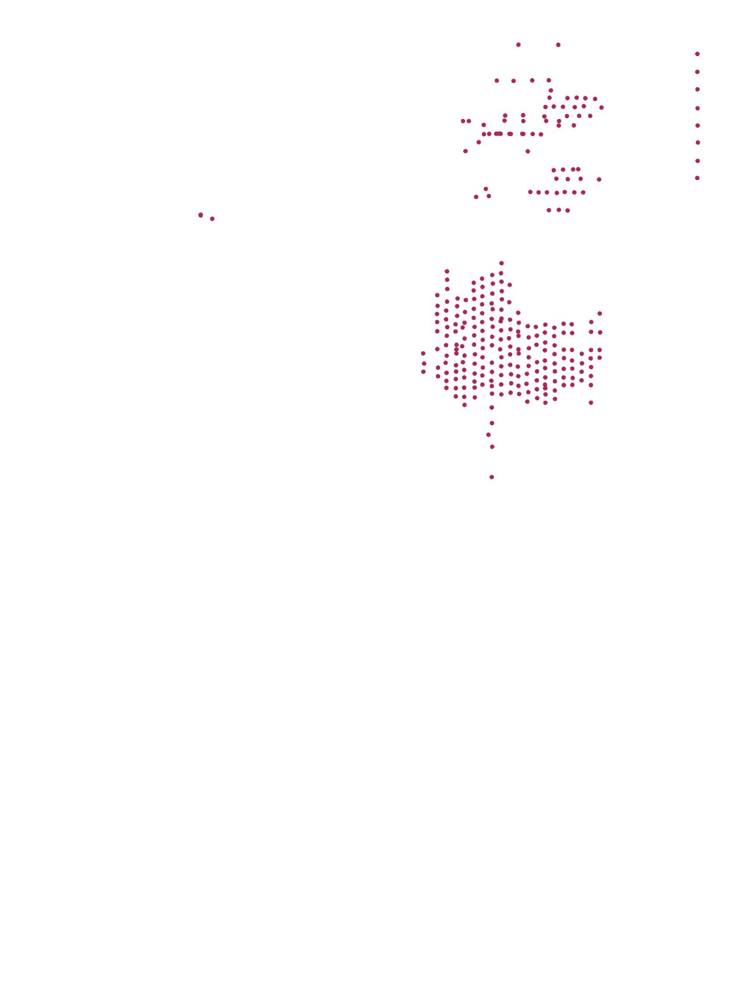
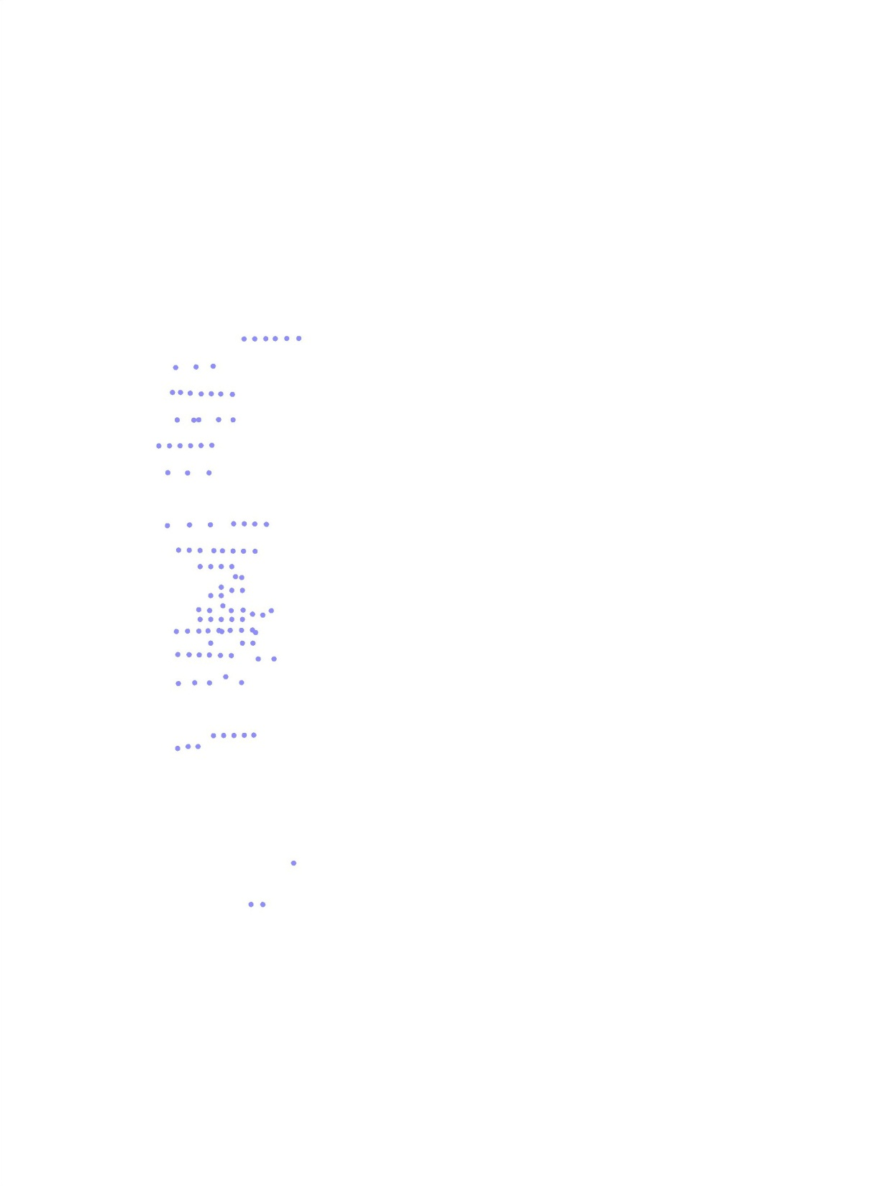
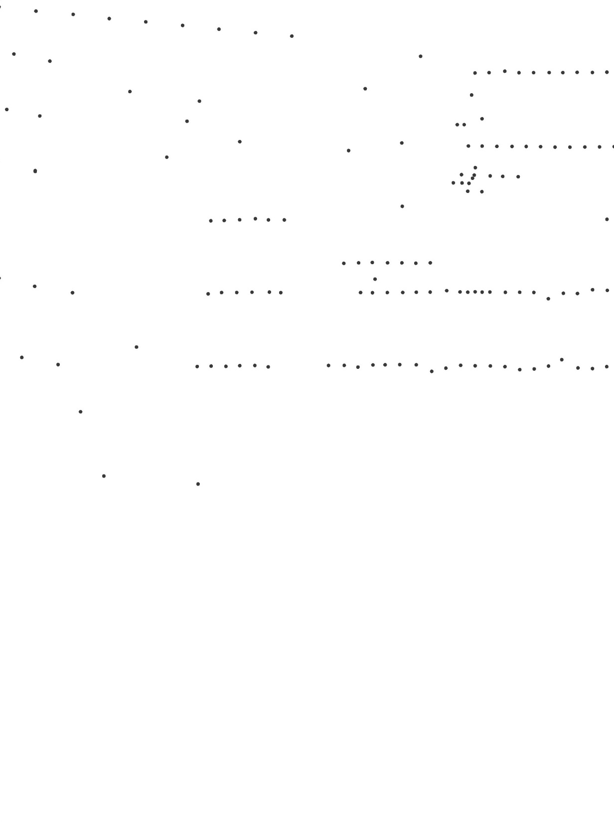
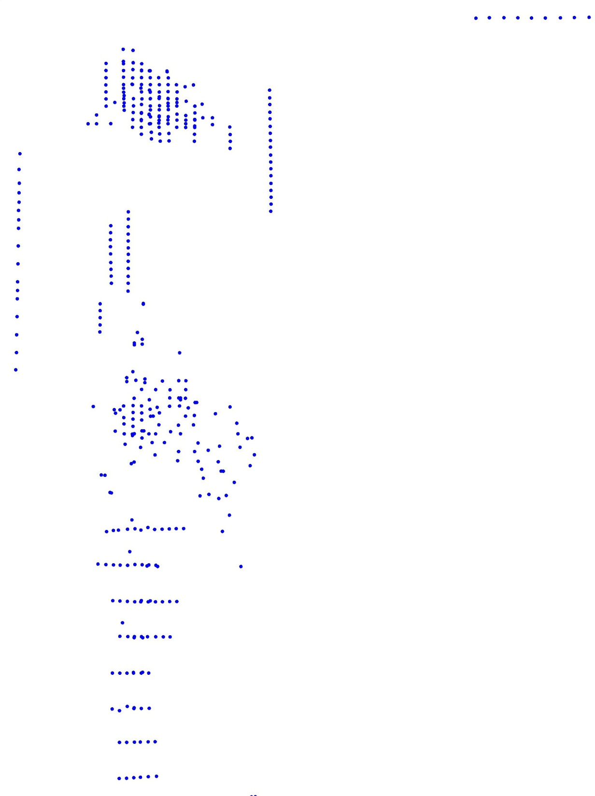


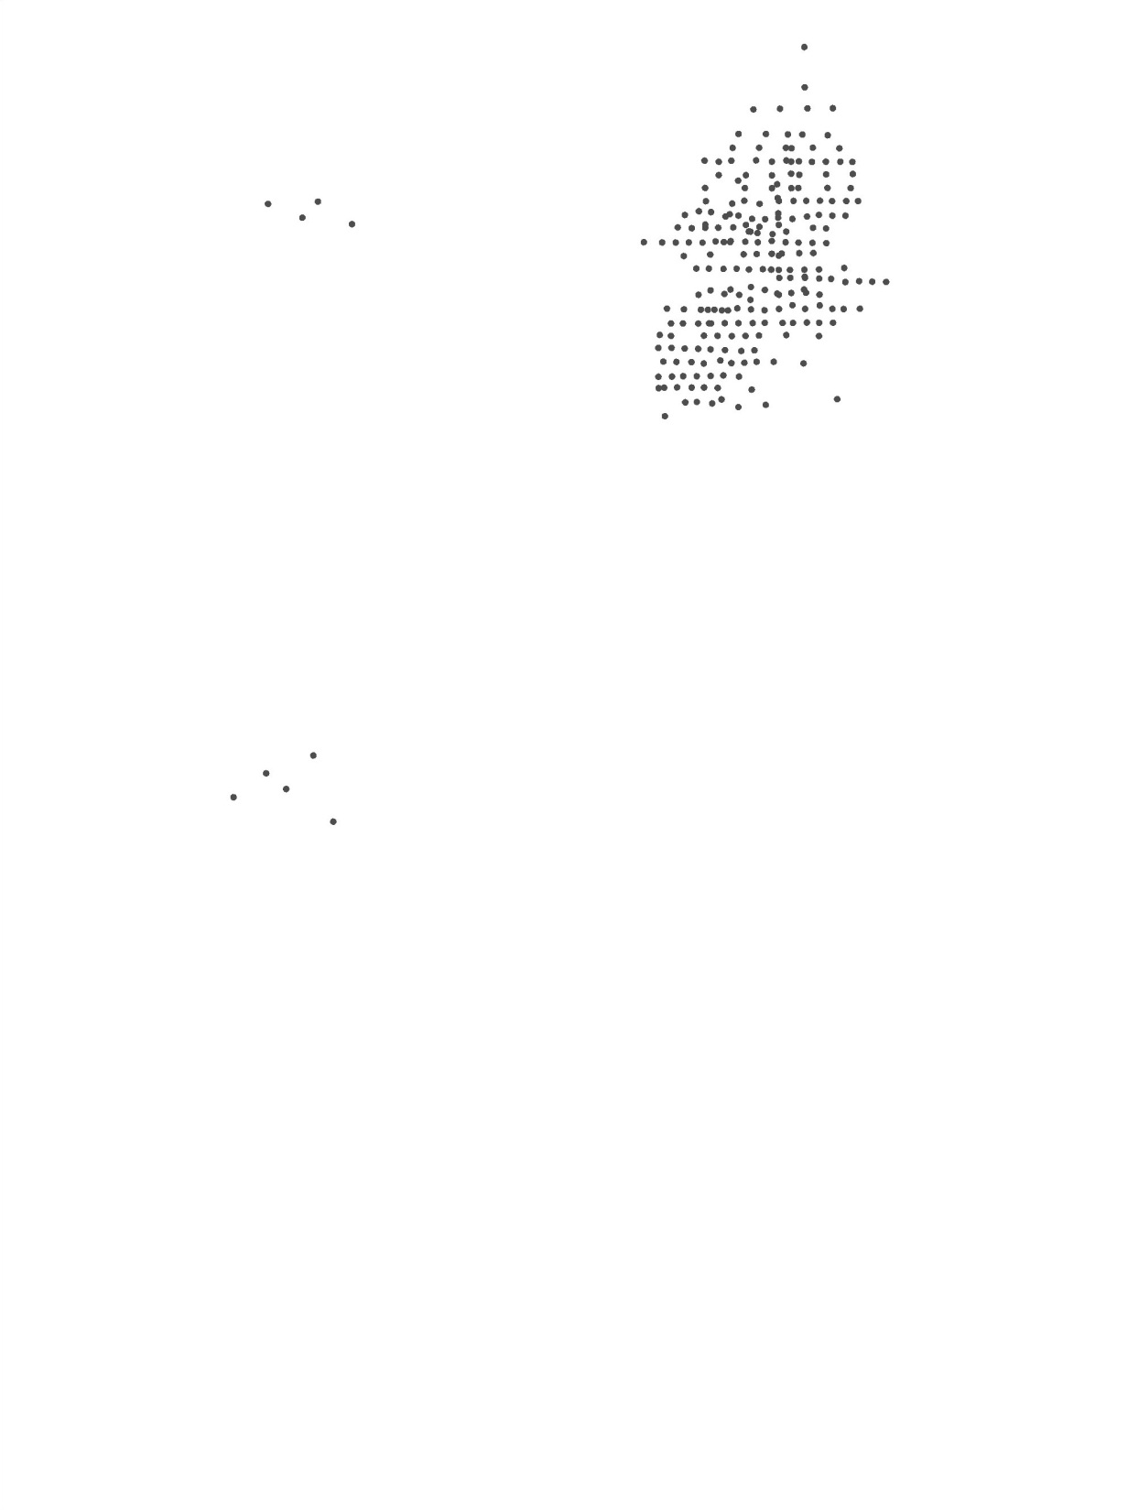

17m @ 9.2g/t Au,
500ppm As
4m @ 0.8g/t Au,
500ppm As to EOH
3m@ 2.4g/t Au, 3200ppm As to EOH
Discovery History
8m @ 1.4g/t Au, 900ppm As + 6m @ 1.3g/t Au, 3000ppm As to EOH
Total resource definition – 2,306 drill holes for 231,504 metres.
Expenditure (incl feasibility and EA) $35 million or $43/ounce (Caloma Two pending)
16m @ 1.7g/t Au,
500ppm As
70m@ 1.9g/t Au, 3000ppm As
17m@ 2.5g/t Au, 600ppm As
11m @ 1.0g/t Au,
1800ppm As
10m @ 0.6g/t Au
3300ppm As to EOH
9m@ 6.9g/t Au, 500ppm As to EOH
14m @ 3.4g/t Au
2100ppm As to EOH
9m@ 110g/t Au, 800ppm As
76m @ 9.1g/t Au,
2.3% As
9m@ 3.1g/t Au, 900ppm As to EOH
Hanging Wall Zone
Compass drilling

Slide 18
Discovery History
Exploration Methodology
Detailed magnetic imagery
Angled pattern air-core drilling – mapping and geochemistry
Early stage diamond core drilling
Persistence – poddy nature of these styled deposits
Notes:
Wyo drilling history

Slide 19
Conclusions
Significant gold mineralisation (~1Mo) defined as a orogenic gold style within Ordovician volcanics of the Eastern Lachlan Fold Belt.
Main exploration tools:
  High resolution aeromagnetics
  Air-core drilling
  Follow up drilling (RC, DD)
Dextral wrenching a significant structural control
Ongoing research of characterising the sulphide mineralisation, inc. S isotopes, K/Ar dating is in progress (Alex Cherry, Honours, UNSW)

Slide 20


